Slide 1
steganography
By Ahmed Mohamed seoudi

Slide 2
Overview of steganography
Steganography hides data inside a file like images, audios, or video
No one can see the hidden data
Steganography hides the existence of the message unlike encryption.
This coursework focuses on image steganography

Slide 3
Project purpose and method
Build a basic steganography app in python
Hide secret message in python
Message can be entered by the user or from a text file
Not relying on libraries to understand the algorithm
The app uses LSB technique

Slide 4
How does the app work
The hidden message gets converted to binary
Message bits are hidden in the LSB of the image pixels
The overall appearance of the image doesn’t change
Bits are extracted and converted to readable text during decoding

Slide 5
Using the app
The app allows hiding and revealing secret messages
Its design is simple and user friendly
The user needs basic python knowledge
The user has option menu to choose from

Slide 6
Running the app
Python must be on the user's device
The program runs through a terminal like visual studio
The user choose an option from the menu
Options available are encoding, decoding, exit

Slide 7
Hiding a secret message
The user select the encoding option
the path of the image or text file must be provided to the app
The message is converted to binary
The binary data is hidden in the LSB
The output is a new image with the secret message

Slide 8
Extracting a secret message
The user select the decoding option
The encoded image path must be provided
The message is extracted from the LSB of the image
Data is the converted to readable text
This process will work if the image went through the previous process

Slide 9
Error handling
The app checks if the image has free space for the message
If there is no free space a message will be printed for the user
The app alerts the user if the file path is written wrong or unavailable
The app prevents crashing by using UTF-8 supported characters only

Slide 10
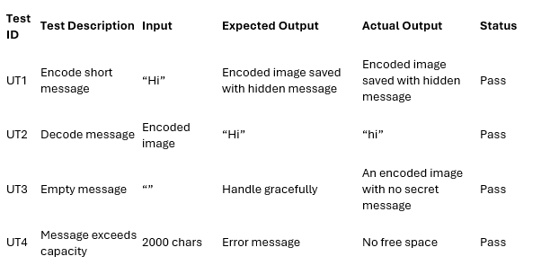
Testing table

Slide 11
Algorithm used
LSB TECHNIQUE
Works with BMP images
Hides secret message inside images bytes
Overall image appearance doesn't change

Slide 12
Problems solved
Checks image free space before encoding
Checks file path
UTF-8 to prevent crashes

Slide 13
Time complexity
Encoding time complexity is O(n)
Decoding time complexity is O(n)

